Slide 1
EEG-to-Text Decoding
By: Abdul Rehman (263179034)

Slide 2
Main Goal
Focused on decoding neural activity from brain signals recorded using Electroencephalography (EEG) during the natural reading of English sentences. The aim is to convert brain signals (EEG data) into readable text in real-time

Slide 3
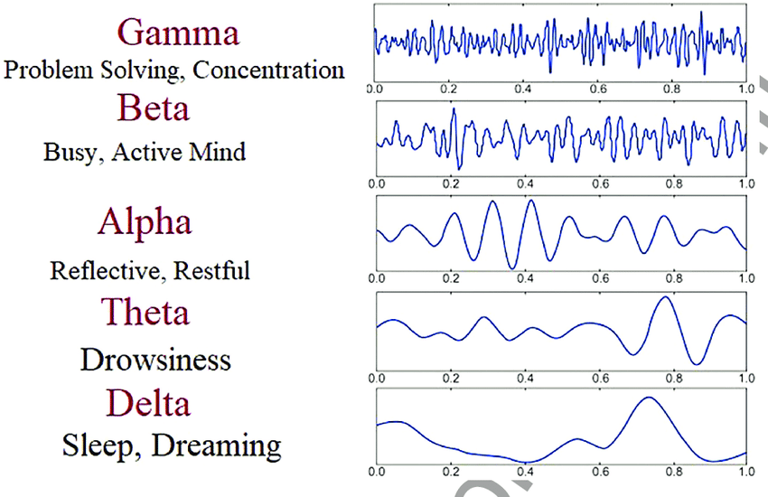
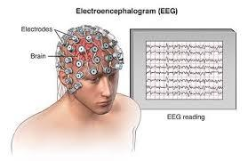
EEG Data Representation
The raw EEG signals are denoted by X∈R^(C×T), where C is the number of EEG channels and T is the number of time steps. The goal is to map these signals to a corresponding text sentence Y consisting of English words.
The objective is to find a decoding function f, which maps the raw EEG signal sequence X and the subject s to the predicted sentence Y.

Slide 4
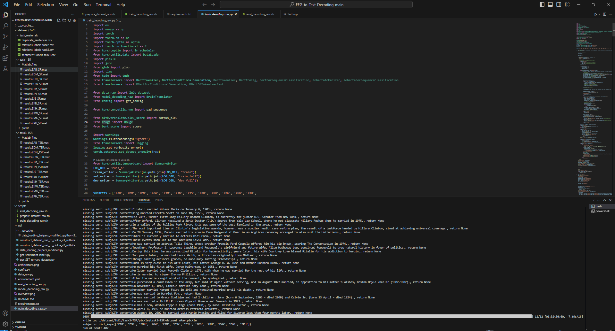
Code Execution

Slide 5
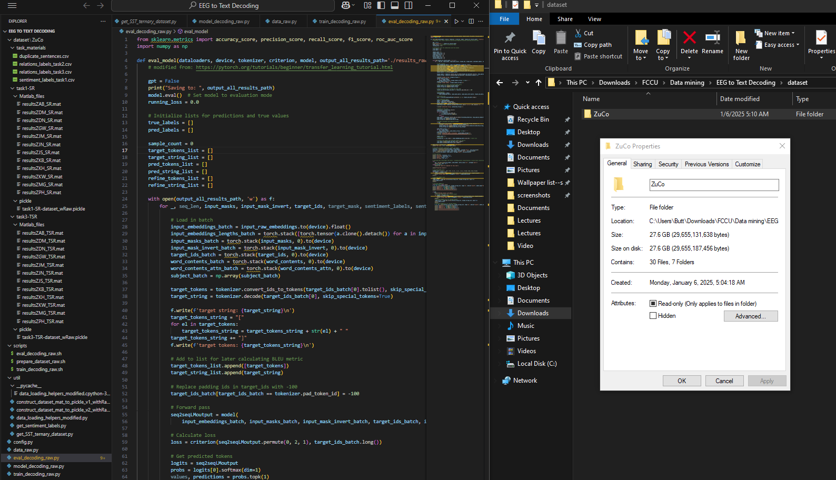
How it works?
We used Convolutional Neural Networks (CNN), Long Short-Term Memory networks (LSTM), and Random Forest models to classify EEG signals and predict text based on brain activity.
The aim is to determine which model works best for decoding EEG signals and predicting text, assessing how accurately and effectively these models perform in this task.
Source: The EEG signals used in this project were recorded from subjects performing various tasks that elicit brain activity, such as thinking or imagining specific actions. [Size: 27. GB] Link: https://osf.io/q3zws/files/osfstorage

Slide 6
How it works?
Features: The EEG signals were divided into different brain wave categories: alpha, beta, theta, and gamma. These brain waves are known to represent different cognitive processes, such as relaxation (alpha) or focus (beta).
Significance: These frequency bands are essential because they contain key information about the brain's electrical activity. By analyzing these signals, we can understand the brain’s state and correlate it to text or language output.

Slide 7
Methodology
Preprocessing: Raw EEG signals often contain noise and unwanted variations, so we applied cleaning techniques to remove noise. The data was also normalized, ensuring that the values were on a comparable scale to avoid biased results. The dataset was then split into training and test sets for model evaluation.
Feature Extraction: The frequency bands (alpha, beta, gamma, delta, theta) from the EEG signals were extracted as features. These frequency bands were used to represent the different cognitive states, providing the information needed for model classification.
Model Selection:
CNN: A deep learning model that excels in capturing spatial relationships, ideal for analyzing the spatial patterns in EEG signals.
LSTM: A type of recurrent neural network (RNN) that is well-suited to sequential data, such as time-series EEG signals, because it can remember long-term dependencies.
Random Forest: An ensemble machine learning method that creates multiple decision trees for classification, making it effective for handling complex datasets.

Slide 8
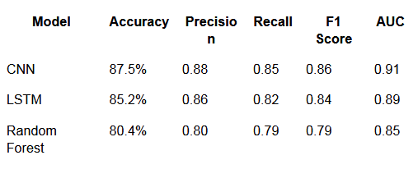
Performance Metrics Overview

Slide 9
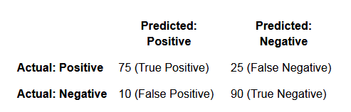

Confusion Matrix & ROC Curve

Slide 10
Feature Importance & Training Curve
Feature Importance (Random Forest): In Random Forest, a feature importance analysis was done to determine which EEG frequency bands were most influential in the classification process. The alpha and beta bands were found to be the most significant, meaning they contribute the most to the model’s predictions.
Training Curve: The loss curve tracks the model’s performance over time. It shows how the model’s error (loss) decreases as it learns from the training data. This helps in understanding whether the model is improving or overfitting (i.e., learning the training data too well, to the detriment of generalization).

Slide 11
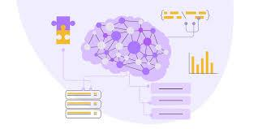
Conclusion & Future Work
Conclusion: The CNN model was the most successful, achieving the highest accuracy and AUC scores. The alpha and beta EEG bands were found to be the most critical for classification. This shows that certain brain wave frequencies are more relevant in decoding text.
Future Work: To improve the results, future work could involve refining the model’s noise-handling capabilities, optimizing hyperparameters for better performance, and experimenting with real-time EEG signal processing for practical applications such as brain-computer interfaces.

Slide 12
Thank You

